Slide 1


Slide 2















▪
▪
▪
▪

Slide 3





▪
BinaryOperation<Integer> max =
(i1, i2) ->
i1 > i2 ? i1 : i2;

Slide 4










▪
BinaryOperation<Integer> max =
(i1, i2) ->
i1 > i2 ? i1 : i2;
▪

Slide 5





▪
BinaryOperation<Integer> max =
(i1, i2) ->
i1 > i2 ? i1 : i2;
▪
▪

Slide 6





▪
List<Integer> ages = ... ;
Stream<Integer> stream = ages.stream();
... max =
stream.max(Comparator.naturalOrder());

Slide 7








▪
List<Integer> ages = ... ;
Stream<Integer> stream = ages.stream();
... max =
stream.max(Comparator.naturalOrder());
▪

Slide 8


▪
List<Integer> ages = ... ;
Stream<Integer> stream = ages.stream();
... max =
stream.max(Comparator.naturalOrder());
▪

Slide 9









▪
List<Integer> ages = ... ; Stream<Integer> stream = ages.stream(); Optional<Integer> max =
stream.max(Comparator.naturalOrder());
▪

Slide 10













▪
Optional<String> opt = ... ;
if (opt.isPresent()) {
String s = opt.get() ;
} else {
...
}
▪

Slide 11






▪
Optional<String> opt = ... ;
if (opt.isPresent()) {
String s = opt.get() ;
} else {
...
}
▪
▪

Slide 12




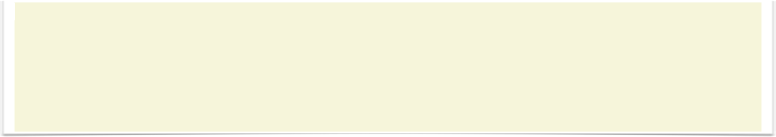
▪
Optional<String> opt = ... ;
if (opt.isPresent()) {
String s = opt.get() ;
} else {
...
}
▪
String s = opt.orElse("") ; // defines a default value

Slide 13





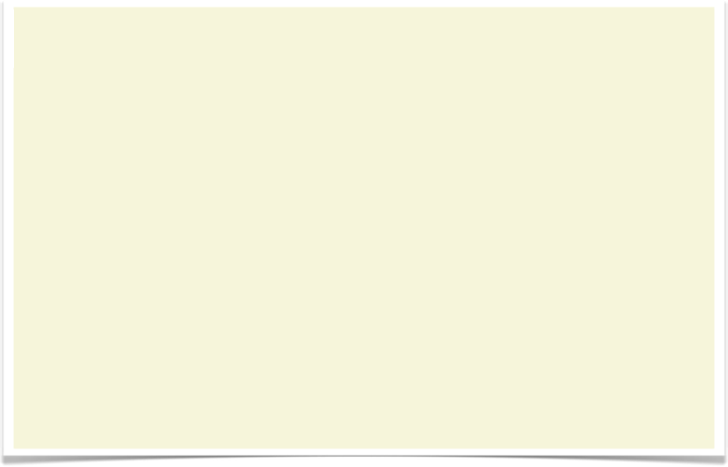
▪
Optional<String> opt = ... ;
if (opt.isPresent()) {
String s = opt.get() ;
} else {
...
}
▪
String s = opt.orElseThrow(MyException::new) ; // lazy construct.

Slide 14






▪
□
□

Slide 15


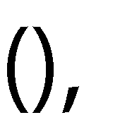

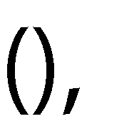


▪
□
□
▪
□

Slide 16




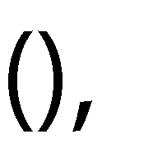

▪
□
□
▪
□
▪
□

Slide 17







▪
▪

Slide 18



▪
List<Person> persons = ...;
Optional<Integer> minAge = persons.map(person -> person.getAge()) | // | Stream<Integer>
.filter(age -> age > 20) | // | Stream<Integer>
.min(Comparator.naturalOrder()); | // | terminal operation

Slide 19

▪
List<Person> persons = ... ;
persons.map(person -> person.getLastName())
.allMatch(length < 20);
// terminal op.

Slide 20







▪
List<Person> persons = ... ;
persons.map(person -> person.getLastName())
.allMatch(length < 20);
// terminal op.
▪

Slide 21














▪
▪
▪

Slide 22




▪

Slide 23



▪
▪

Slide 24








▪
▪
▪

Slide 25










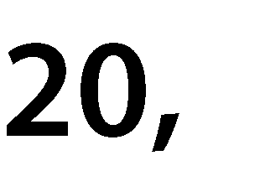


▪
List<Person> persons = ... ;
String result = persons.stream()
.filter(person -> person.getAge()
.map(Person::getLastName)
.collect(
Collectors.joining(", ")
);
> 20)
▪

Slide 26









▪
List<Person> persons = ... ;
List<String> result = persons.stream()
.filter(person -> person.getAge()
.map(Person::getLastName)
.collect(
Collectors.toList()
);
> 20)
▪

Slide 27












▪
List<Person> persons = ... ;
Map<Integer, List<Person>> result = persons.stream()
.filter(person -> person.getAge() > 20)
.collect(
Collectors.groupingBy(Person::getAge)
);
▪
□
□

Slide 28








▪
List<Person> persons = ... ;
Map<Integer, List<Person>> result = persons.stream()
.filter(person -> person.getAge() > 20)
.collect(
Collectors.groupingBy(Person::getAge)
);
▪

Slide 29









▪
List<Person> persons = ... ;
Map<Integer, Long> result = persons.stream()
.filter(person -> person.getAge() > 20)
.collect(
Collectors.groupingBy(
Person::getAge,
Collectors.counting() // the downstream collector
)
);
▪

Slide 30





















▪
□
▪

Slide 31







▪
□
▪
▪
▪
▪

Slide 32

















▪
▪
▪

Slide 33














































